Slide 1
Team: The Darkness
Wyatt Morris
Juan Crispi
Chance Leaird

Slide 2
Introduction
We started looking at the project Evergreen
Evergreen is an opensource library management software
Due to the overwhelming complexity and the dependencies we decided on a simpler project

Slide 3
Fuzzywuzzy
Fuzzywuzzy is a simple string comparison module
Written in python
Only real dependency is having python 2.7 or later installed
Uses the standard difflib and string parsing to make it possible to compare if strings are relatively the same

Slide 4
Methods we chose to test
These are all from the fuzz module within fuzzwuzzy
ratio
partial_ratio
QRatio
UQRatio
WRatio
All of these methods take at least two input strings

Slide 5
Test Cases
We decided on five basic test cases to demonstrate that the methods were consistent and could handle some fringe cases
This is a test vs This is a tess
Empty string vs a
a vs b
a vs Aa
This is a test vs Empty string

Slide 6
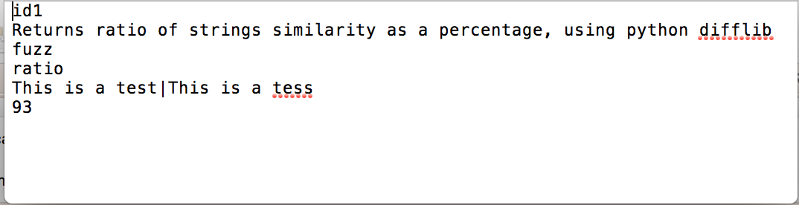
Test Case File
Our test case files follow the below format
Test id
Requirement
Module tested
Method tested
Input tested, seperated by “|”
Expected output

Slide 7
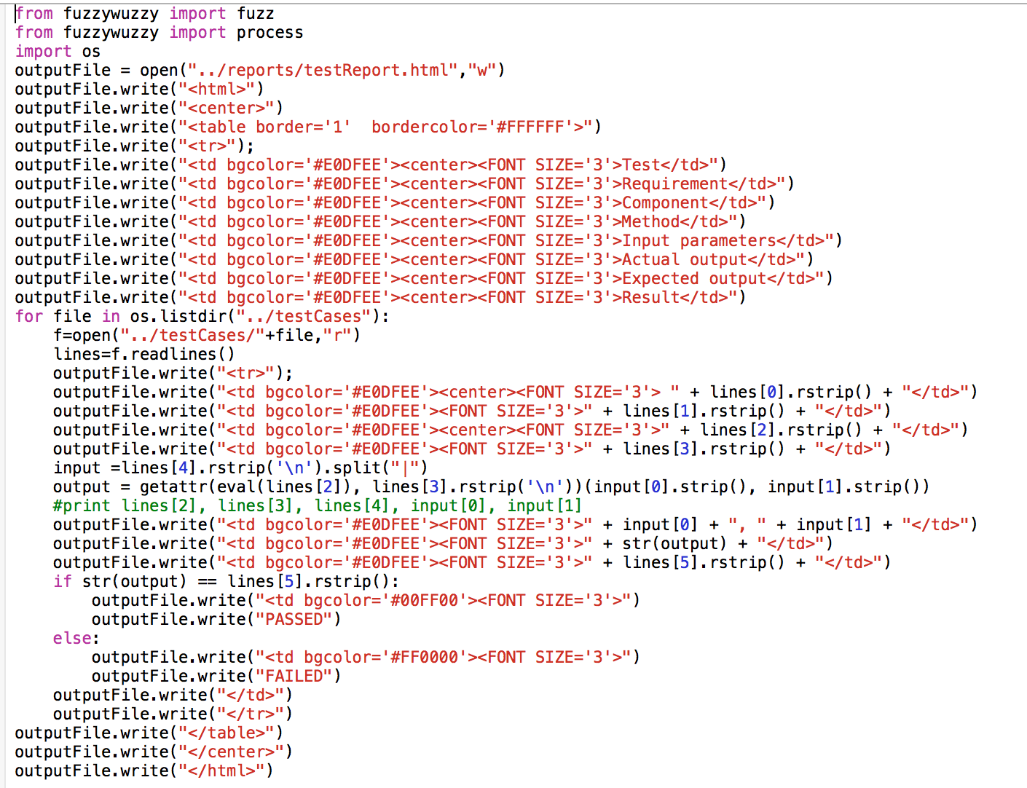
Testing Script
Our testing script looks in the testCases directory and parses every text file to determine what method and inputs to test and what the expected output is

Slide 8
Test Report
Input is taken from test case files
Test report is a formatted table and is an html file
Outputs are read from text file and the output of method called

Slide 9
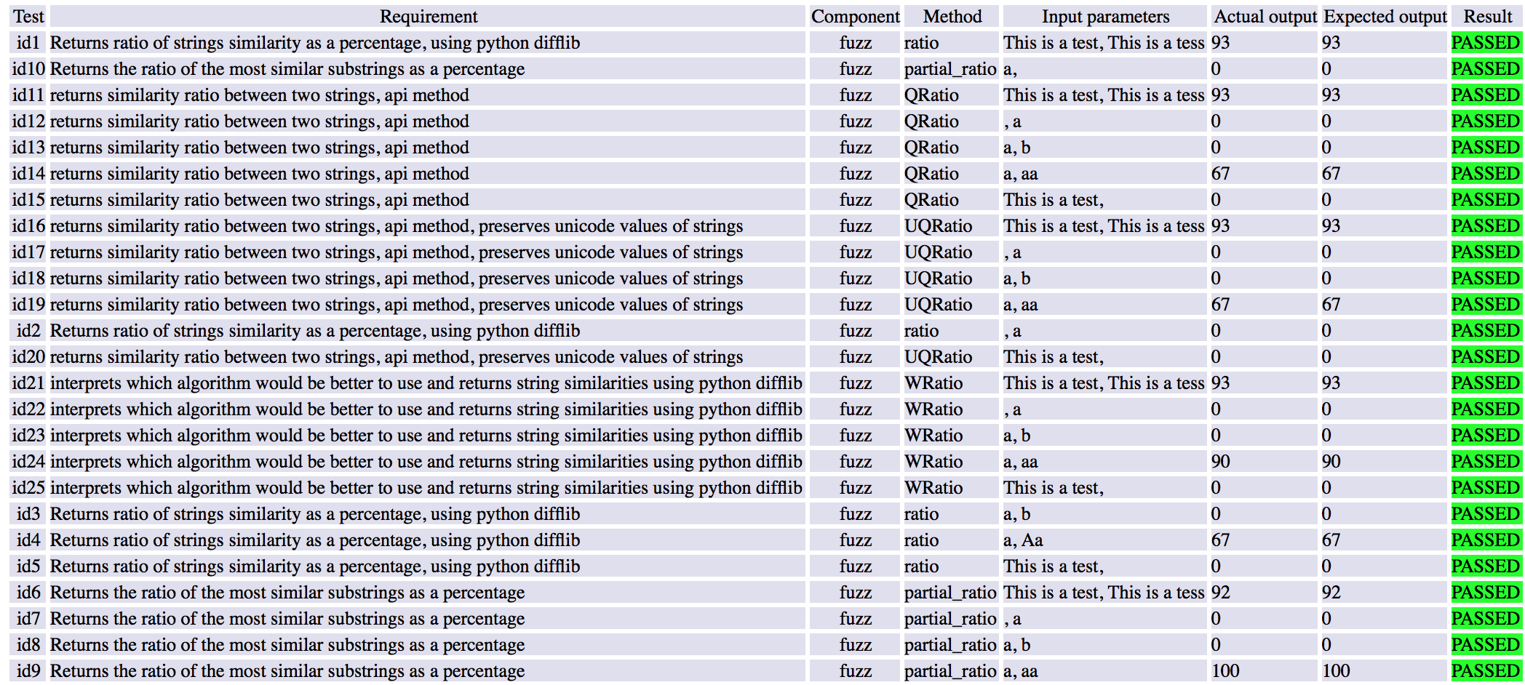

Slide 10
Faults
Our five faults include altering arithmetic expressions and constants
Altered a constant and arithmetic expression in fuzz.ratio
Altered a constant in fuzz.partial_ratio
Altered two constants in fuzz.QRatio

Slide 11
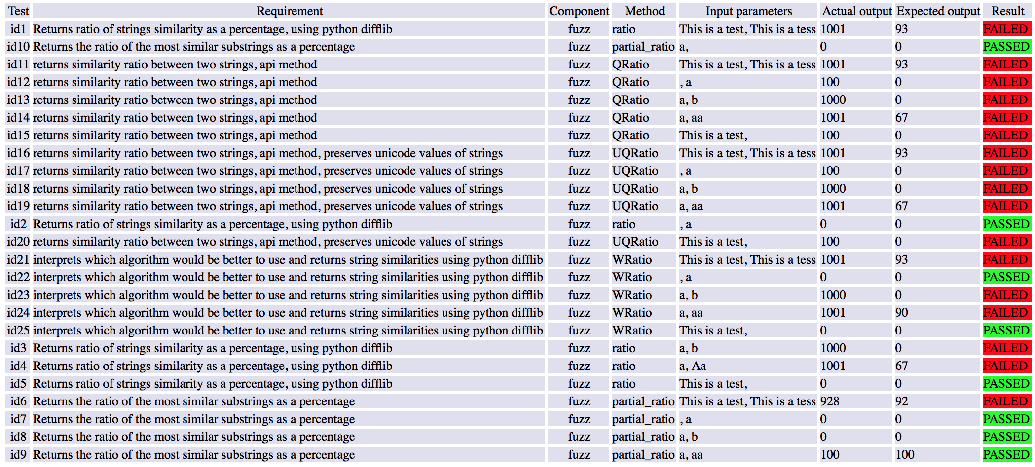
Test Report with Fault Injections

Slide 12
Modifications
Oracles were determined by hand, would like to automate that
All methods tested are in the fuzz.py file, would like to test outside of module
Script is only designed to handle two inputs, change to handle varied sizes of inputs
Expand test case pool

